Slide 1
First Failures: VisiStick
Kyle Ayers
Seth Teichman

Slide 2
Problem Statement:
People who have extreme vision impairment and use blind canes can only sense their environment up to the end of their cane. A device is needed that will enable them to sense obstacles further than their cane through distance sensors.
We are working with Jamila, an employee of NABA, on a solution for her.
Constraints - iPhone, BT earbud

Slide 3
Milestones Passed:
Found a concept that doesn’t interfere with any other patents.
Modeled the Mechanical concept in Inventor.
Conceptualized the Electronic and Programming aspects of the concept.
Purchased and constructed prototypes of the Electronics Modules.
Gathered Reliable data from the sensor on the Communication Module.
Connected an iPhone to the Arduino System to view raw data over Bluetooth.

Slide 4
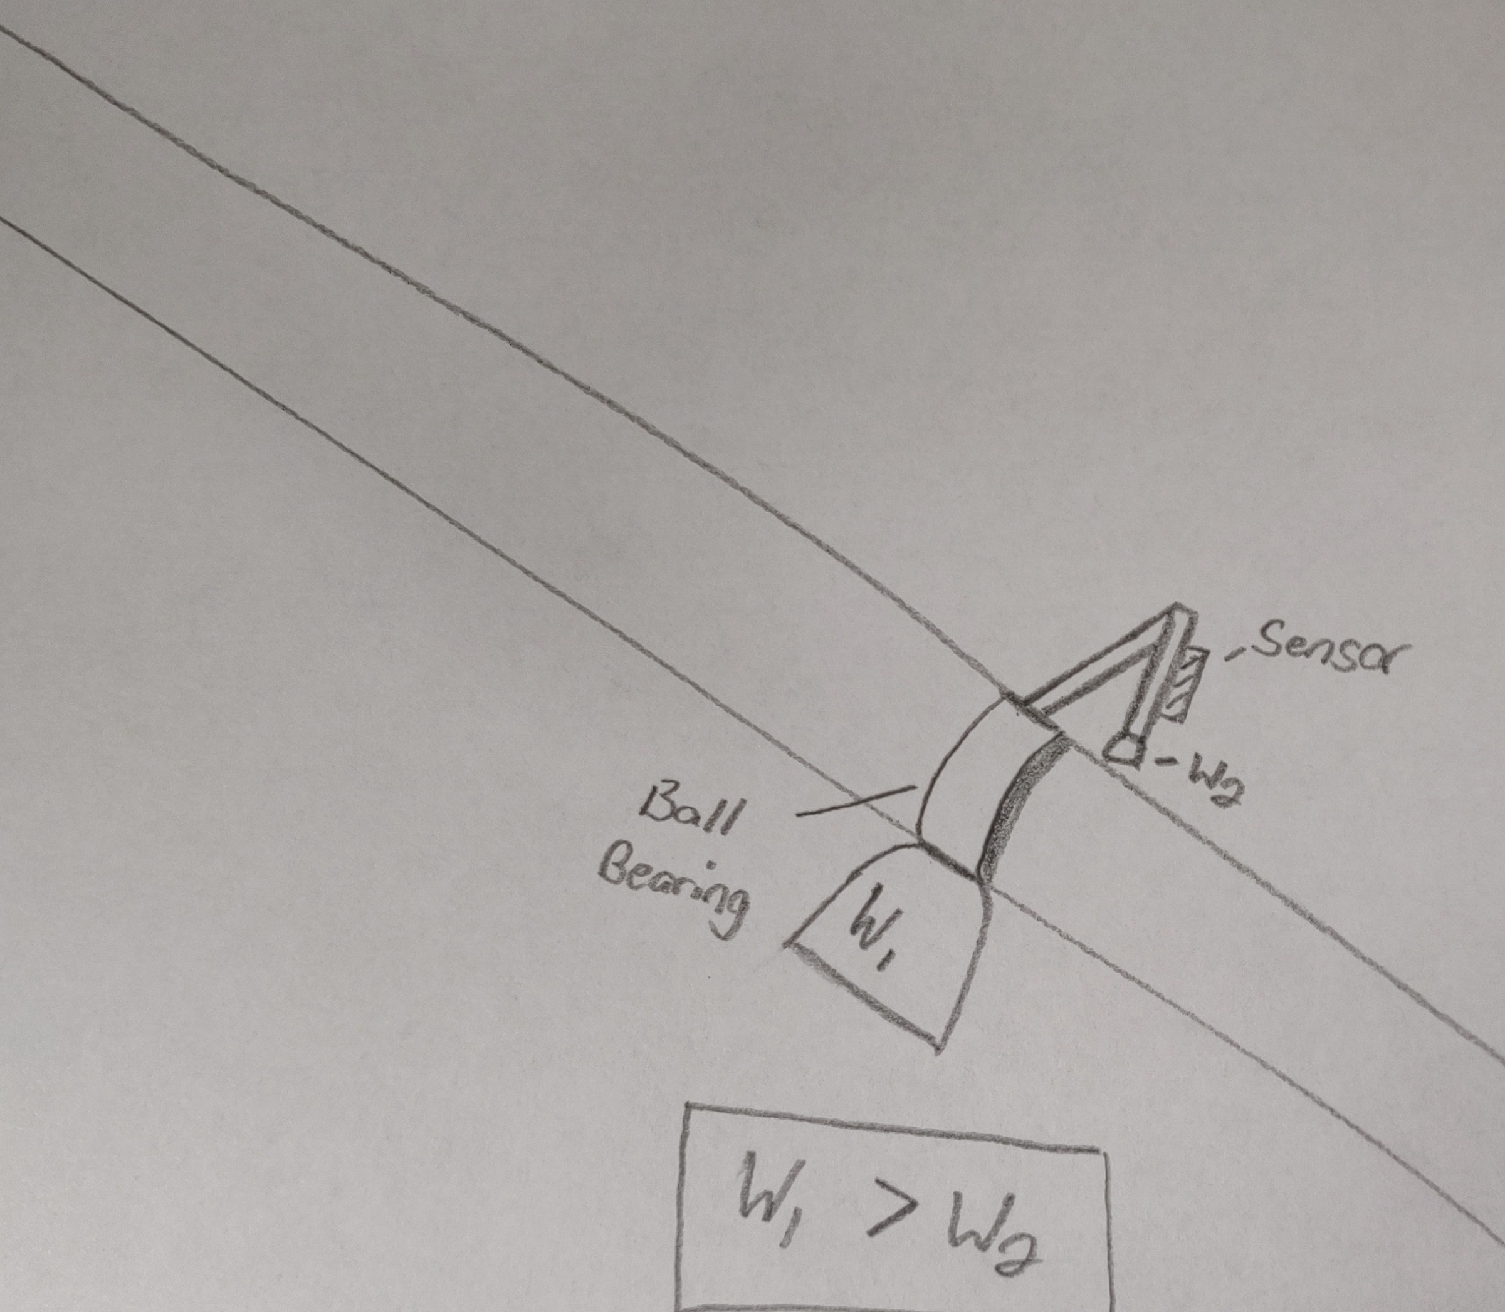
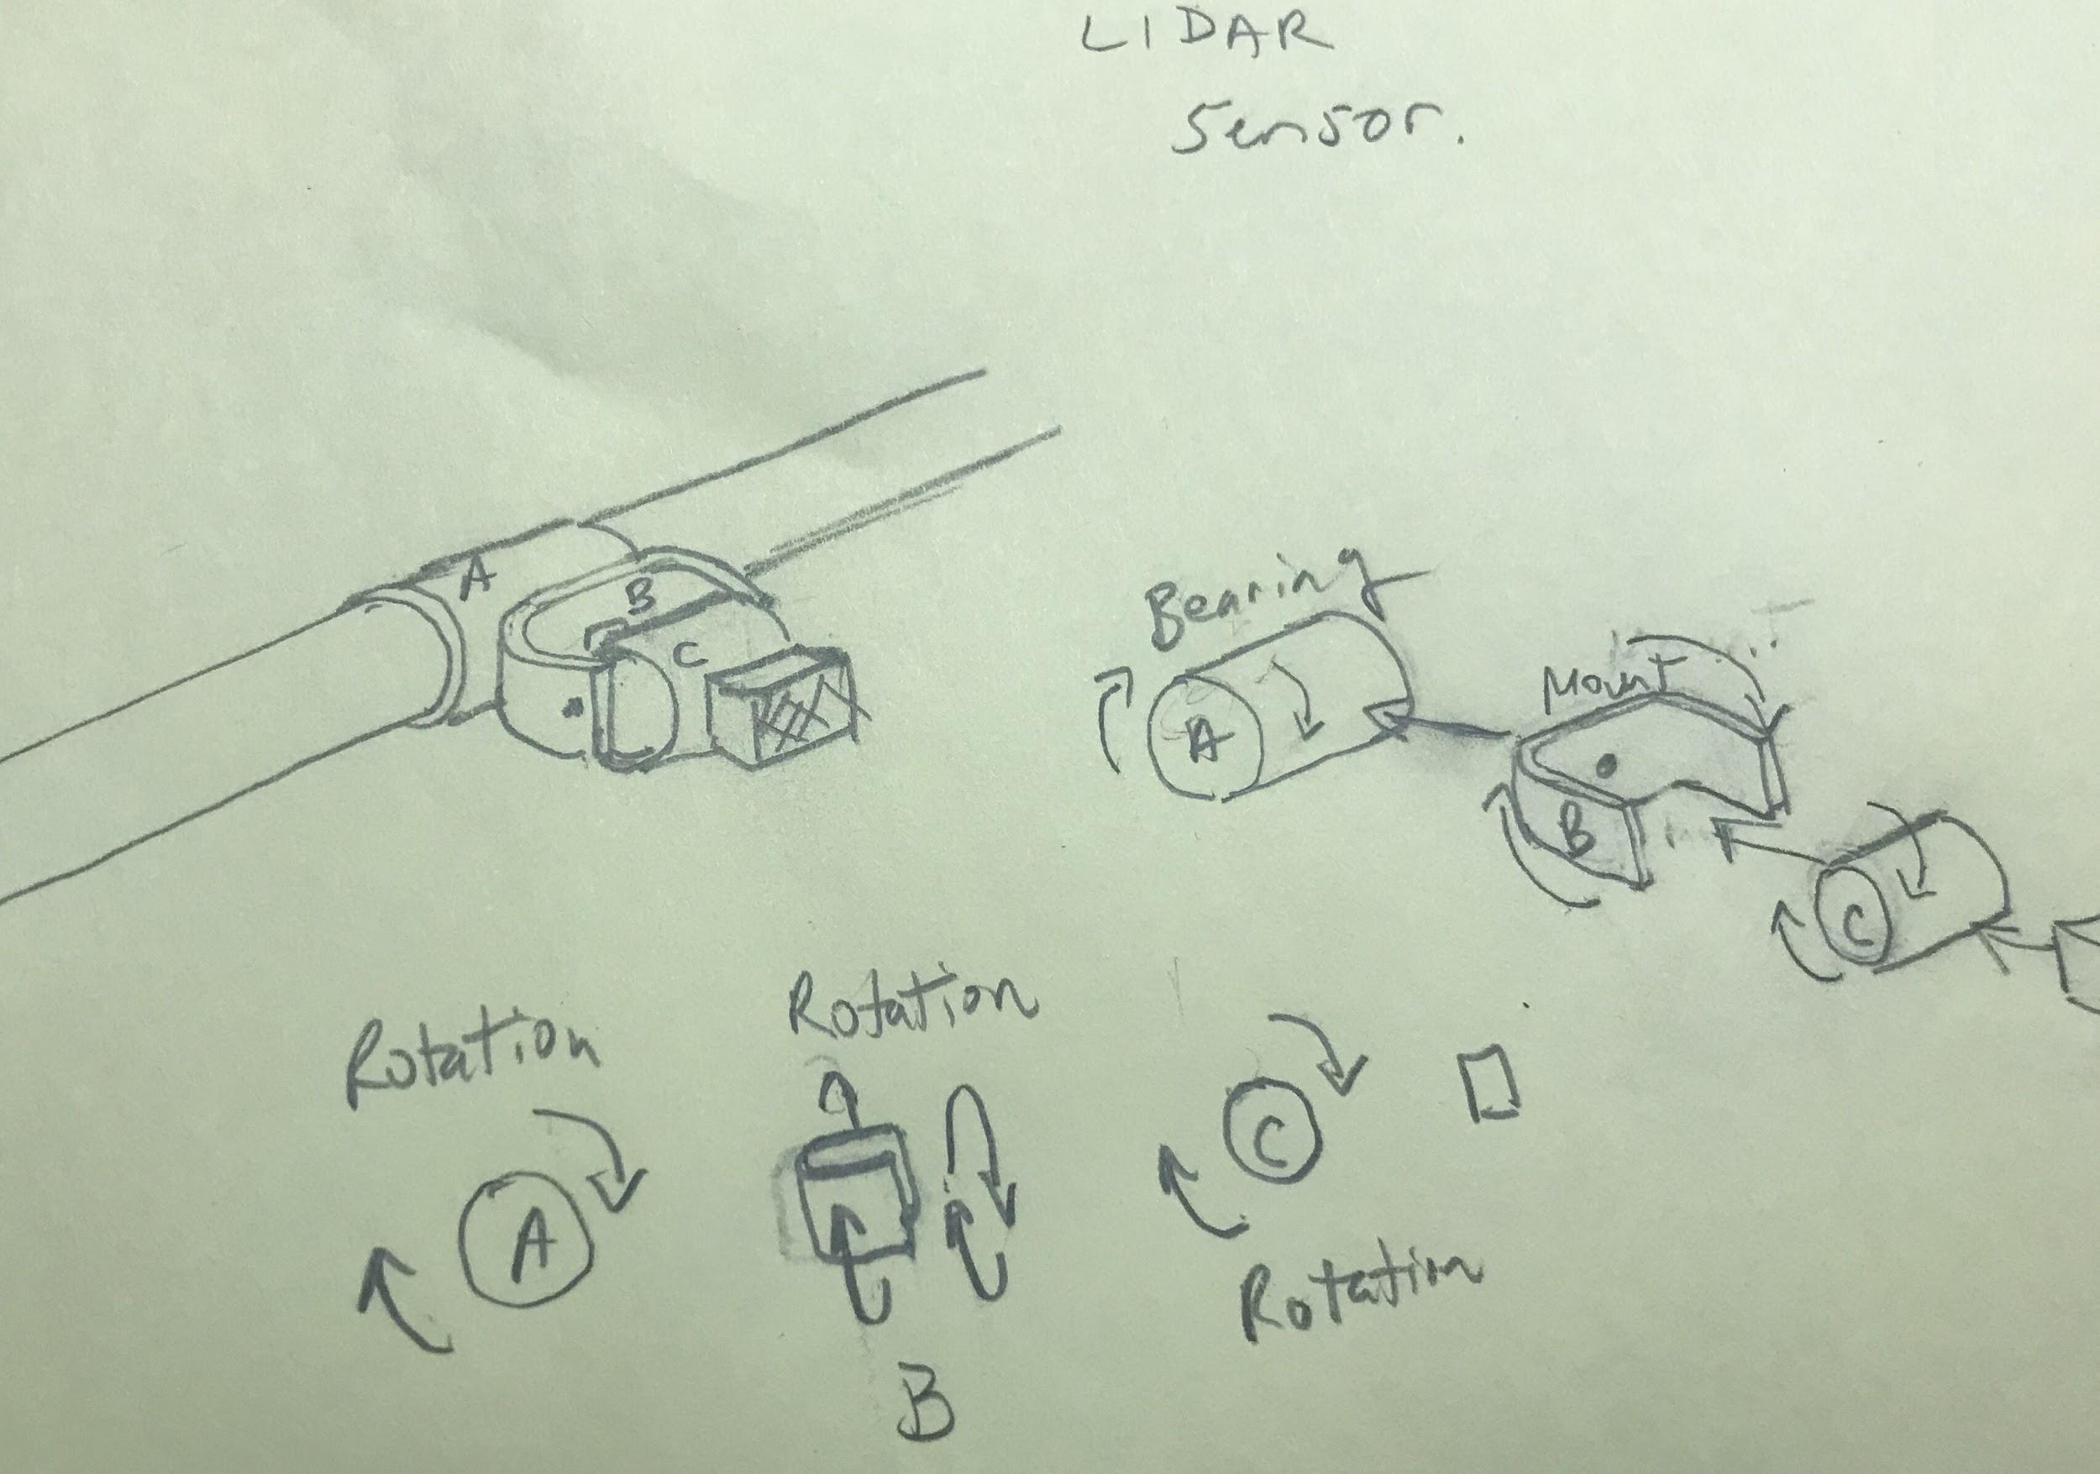
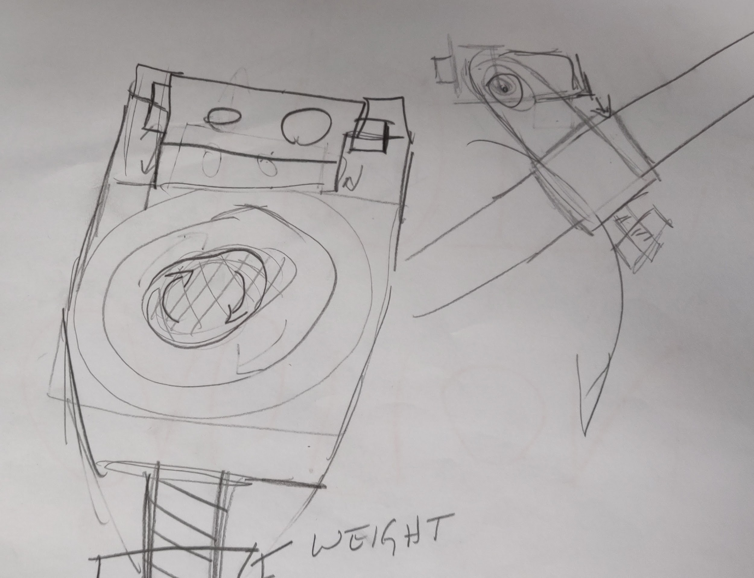
All Attempts Towards Problem
1 | 2 | 3

Slide 5
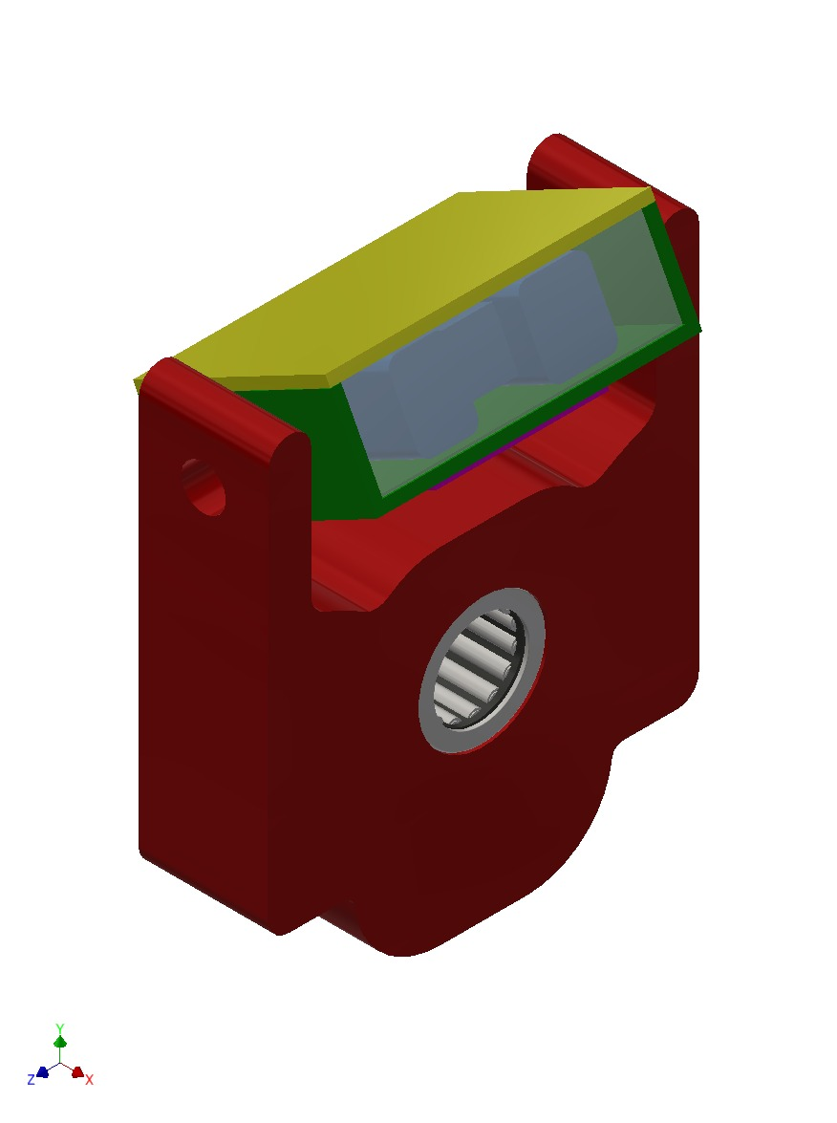
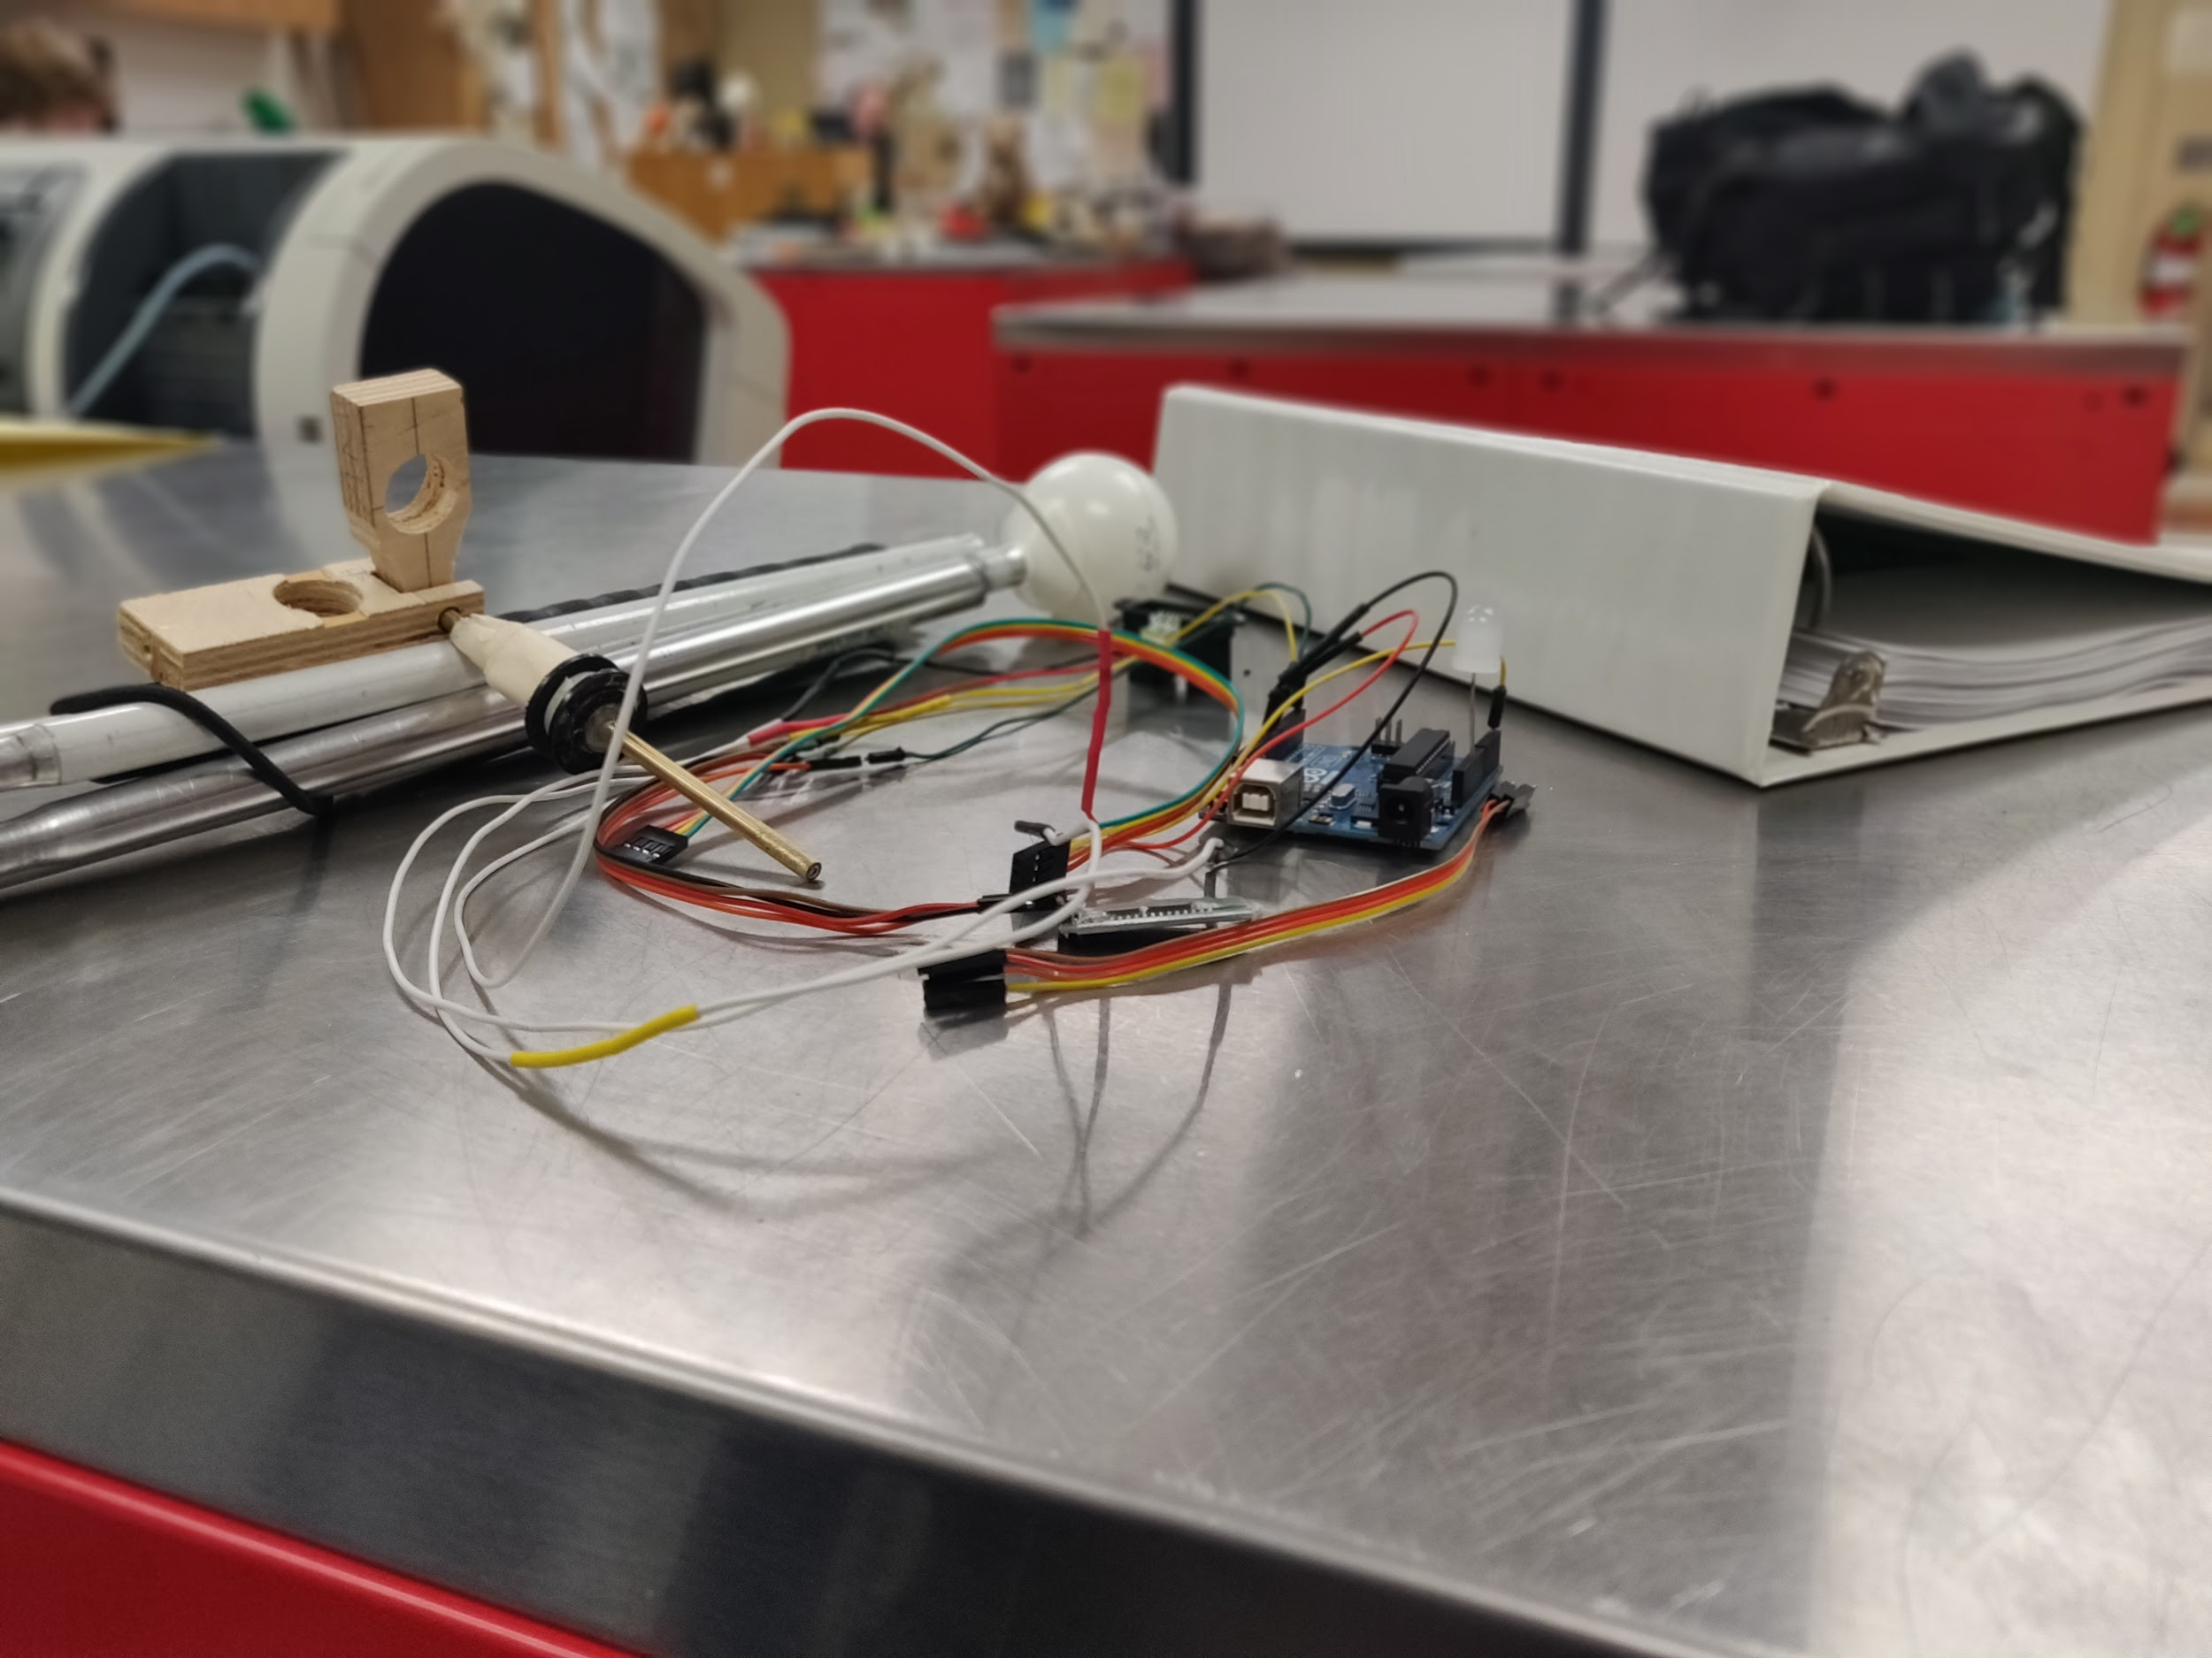
Physical Models:
Physically, we only have the electronic communication module.
We have designs that we are planning to produce shortly of a stabilizer for the sensor, such that data will be reliable when attached to the blind cane.
Currently, we are designing a power supply module that will allow the communication module to be powered while untethered from a wall outlet or computer.
Sensor Stabilizer Module
Electronic Communication Module

Slide 6
Expenses:
Part | Part Number | Quantity | Unit Price | Cost | Running Total
Arduino UNO | A000066 | 1 | $22.00 | $22.00 | $22.00
Sharp Lidar Sensor | GP2Y0A02YK0F | 1 | $14.95 | $14.95 | $36.95
Begin First DigiKey Order (12/18/18) (Sales Order #57795645) |  |  |  |  | $36.95
Bluefruit LE UART Friend | 1528-1350-ND | 1 | $17.50 | $17.50 | $54,45
LiIon Charger Board | 1528-1833-ND | 1 | $6.95 | $6.95 | $61.40
USB C Breakout | 1568-1958-ND | 1 | $4.50 | $4.50 | $65.90
USB MicroB Breakout | 1568-1192-ND | 1 | $4.25 | $4.25 | $70.15
Battery 3.7V 2.5AH | 1528-1840-ND | 1 | $14.95 | $14.95 | $85.10
Boost Converter | 1568-1155-ND | 1 | $15.95 | $15.95 | $101.05
JST 2 Pin Cable | 1528-1126-ND | 1 | $0.75 | $0.75 | $101.80
Rocker Switch | CH807-ND | 1 | $1.27 | $1.27 | $103.07
End First DigiKey Order |  |  |  |  | $103.07
Labor Costs (Seth) | N/A | 57.2 hours | $10.00/hr | $572.00 | $675.07
Labor Costs (Kyle) | N/A | 52 hours | $10.00/hr | $520.00 | $1,195.07

Slide 7
What we’re Doing to Remedy the Issues:
Mechanical (Seth): Trying to create a physical model to test the movements of the modeled concept
Programming (Seth): Since our client uses an iPhone, I’ve been learning how to write code in Swift for iOS App Development, so we can make a product that she can use easily, without any major adjustments to how she does things currently.

Slide 8
Responsibilities for the Next Month:
Mechanical (Kyle): Finding the right material for the parts involved and creating a physical prototype
Programming (Seth): Create a custom app and Simple Algorithm to map out data in an arc, since that is the motion used to feel out the environment.
Electrical (Seth): Construct the power supply module, so we can put all of the components together for a unit test.

